Slide 1
Convolutional Neural Network-Based Shadow Detection in Images Using Visible Light Camera Sensor

Slide 2
WHY?
shadows make it difficult to detect and recognize the exact human area.
Near-infrared (NIR) light cameras and thermal cameras are used to mitigate this problem. However, such instruments require a separate NIR illuminator, or are prohibitively expensive.

Slide 3
Existing Research:
Existing research on shadow detection in images captured by visible light cameras have utilized object and shadow color features for detection. Unfortunately, various environmental factors such as illumination change and brightness of background cause detection to be a difficult task.
Existing methods of detecting and removing shadow use shadow chromaticity of various color spaces

Slide 4
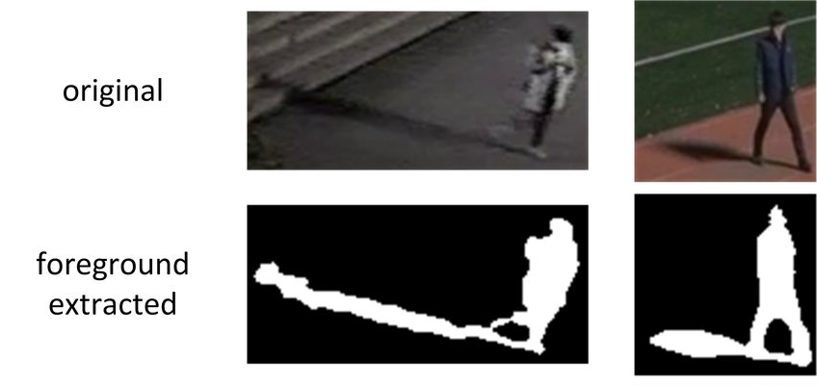
Why shadow a problem?
Surveillance camera systems use the background subtraction operation, which detects the foreground to detect a moving object.
Particularly, the shadow is a typical barrier that makes exact detection of foreground and recognition of objects difficult.
The detection error for a shadow may cause an object to be identified as a larger object.

Slide 5
Why shadow needs to be removed?
The detection error for a shadow may cause an object to be identified as a larger object.
In the real-time surveillance system for an outside environment, this error can cause a man to be mistaken for a vehicle.
Moreover, the shadow detection error causes another problem related to human detection, because multiple people can be detected as one human.
This is because size information is a key factor in detecting and recognizing humans.

Slide 6
Proposed Solution
A convolutional neural network (CNN)-based shadow detection method:
We convert input image of red-green-blue (RGB) color into that of hue-saturation-value (HSV) coordinate to remove the effect of hue channel which causes the error of shadow classification.
As the input to CNN, we use an image of three channels including the saturation and value images of input, and the ratio image of value images of input to background.
The searching region including a rough area of foreground and shadow is determined by background subtraction. To reduce the processing time, only the 21 × 21 sliding window extracted from this searching region is used for the input to VGG Net-16 model.

Slide 7
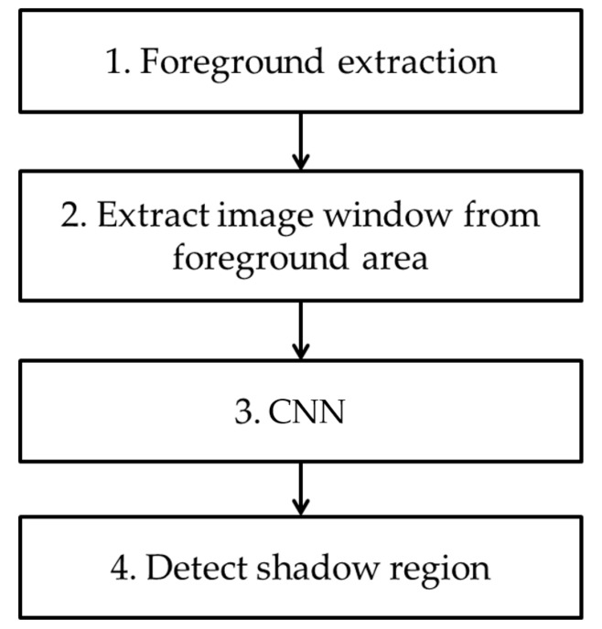

Slide 8
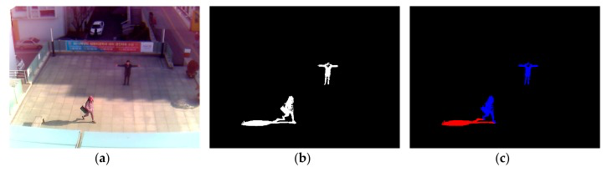
Background Subtraction/ Foreground Extraction:
a foreground region is detected through background subtraction using the background image.
After obtaining a foreground region via background subtraction, non-shadow (i.e., human) and shadow areas are manually separated as ground-truth regions for CNN training
That is, the shadow pixels among the white pixels are manually painted as red color by the observation of human developer, and the remaining white pixels are automatically converted into those of blue color.
This is ground-truth data, and it is used for CNN training and measuring the accuracy of shadow detection in our experiment.

Slide 9
Extraction of window image
a window image with a 21 × 21-pixel size is extracted from the detected foreground region. After the extracted window image is resized to a 224 × 224-pixel size
based on the positions of ground-truth regions, the window images of 21 × 21 pixels are extracted from the original input image.
For example, the window whose center belongs to the blue region is determined as a non-shadow area. Whereas, the window whose center belongs to the red region is determined as a shadow area.
The window image of 21 × 21 pixels is extracted from the input image of HSV color space instead of RGB color space.

Slide 10
Why HSV Color Space?
The existing researches have assumed that shadow darkens the background but retains its color, whereas the chromaticity of a human figure shows a more diverse change against the background.
Based on the result of these researches, we experimentally determine that the HSV color space is the most suitable for representing shadow features. Accordingly, input and background images are transformed into an HSV color space.
The size of generated window image is 21 × 21 × 3 (i.e., width × height × channel). Window images extracted from training data are used for CNN training.

Slide 11
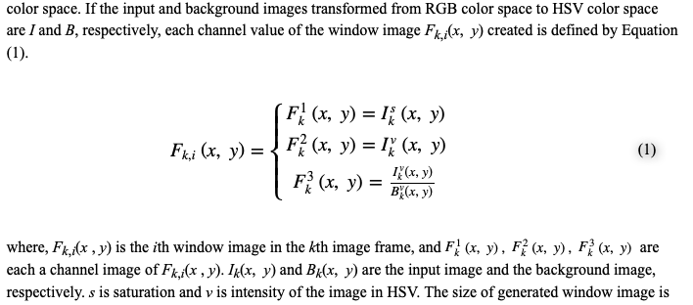

Slide 12
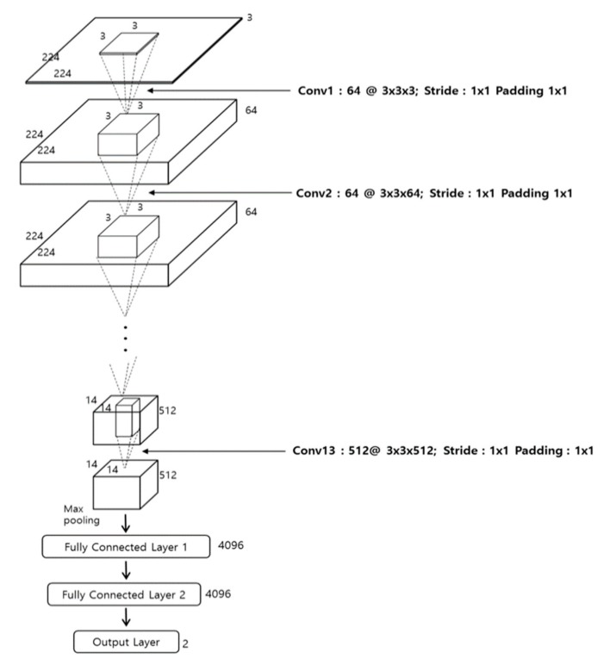
VGG-16 Net:

Slide 13
VGG-16 NET:
The VGG Net-16 consists of a total of 16 layers, including 13 convolutional layers and three fully connected layers (FCL).
Every convolution layer is connected to the rectified linear unit (ReLU) layer.
We apply fine-tuning to the network, which is pre-trained through the ImageNet dataset

Slide 14
Input to CNN:
The initial image size of this CNN is 224 × 224 × 3.
Accordingly, we conduct bilinear interpolation to resize the three-channel 21 × 21 window image, which is obtained from HSV color space, into the three-channel 224 × 224 image, which is used as the input of CNN.

